Slide 1
Attachment
5-2
① International Student House（Chofu）（for Minami-Osawa C & Hino C Students）
Closest Station | Keio Tamagawa Sta.（8 minutes' walk ）, Keio Chofu Sta.（15 minutes' walk）
Address | 6 Tamagawa, Chofu-shi, Tokyo
Monthly Rent | 66,000 yen （Room rate, facilities charges, utilities charges, Internet connection fee included）
Deposit | 30,000 yen （Refundable after deduction of cleaning fee at the move-out time; if repair fee charged, it will be also deducted.）
Term of Contract | September 1, 2017 to August 31, 2018 （The contract can be cancelled in the middle of the term.）
Type of Room | Unit Type: Shared dining room and 3 private rooms; （one person）/1R（approx. 10㎡）
Commuting Time | 【Minami-Osawa C】20 minutes （No transit）, Commuter Pass：4,160yen/month（Minami Osawa Station on Keio Sagamihara Line ) 【Hino C】43 minutes （2 transits）, Commuter Pass：9,450yen/month（Toyota Station on JR Line )
Unit facilities（Private Room） | Air Conditioner, Bed, Desk, Chair, Refrigerator, and Wireless LAN A Set of Bedding (Comforter, Blanket, etc.), Pillow, Sheet (rental fee: 14,000 yen)
Unit facilities（Shared Rooms） | Living Room, Mini-kitchen, Shower Room, Washbasin, Toilet, Air Conditioner
Facilities (Shared Space) | Lounge, Kitchen, Toilet, Washing Machin (coin-operated), Dryer (coin-operated), kitchen Ware, TV, Wireless LAN, Parking Lot, etc.
Utilities (Electricity, Water, Gas, Internet) | Included in the monthly rent
Note | The rent will not be pro-rated for September, 2017 and August, 2018.

Slide 2
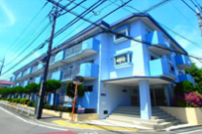
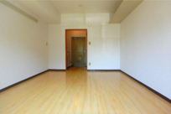
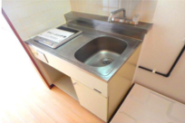
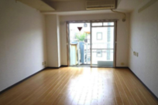
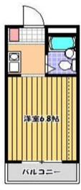
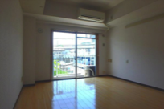
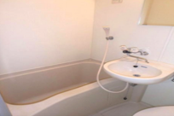
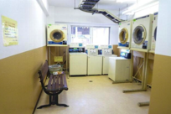
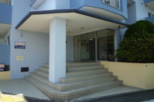
②Housing Information (for students who belong to Miami Osawa Campus)
Attachment
5-2
Closest Station | Keio Tama-Center Station (10 minutes’ walk)
Address | Nakazawa, Tama-shi, Tokyo
Monthly Rent | 60,000yen
Term of the Contract | September 1, 2017 to August 31, 2018 （The contract cannot be cancelled in the middle of the term.）
Type of the room | Single (1 person) /1R（12.4㎡）
Commuting time | 3 minutes （No transit）, Commuter Pass：2,160yen/month（Minami Osawa Station on Keio Sagamihara Line )
Facilities | Bed, a Set of Bedding (Comforter, Blanket, etc.), Pillow, Sheet, Desk, Chair, Refrigerator, Rice Cooker, Microwave Oven and Air Conditioner
 | Coin-operated Washing Machine （200 yen/per time）, Dryer （100 yen/15minutes）, Internet (monthly subscription fee 5,000yen)
Utilities | Make a contract with utilities companies and pay them each directly (Electricity, Gas and Water)
Notes | 1． Rent for September 2017 and August 2018 will not be calculated on a per-diem basis even the student moves in/out in the middle of the month. 2． Available accommodation may not be same as above, depending on arrangements.

Slide 3
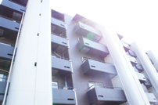
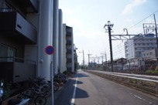
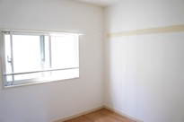
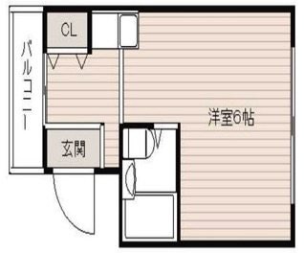
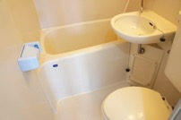
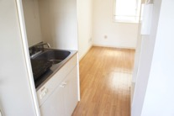
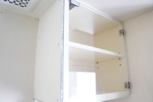
③Housing Information (for students who belong to Hino Campus)
Attachment
5-2
Closest Station | Hachioji Station (9 minutes’ walk)
Address | Tera-machi, Hachioji-shi, Tokyo
Monthly Rent | 60,000 yen
Term of the Contract | September 1, 2017 to August 31, 2018 （The contract cannot be cancelled in the middle of the term.）
Type of the room | Single (1 person) /1R（10.94㎡）
Commuting time | 4 minutes（No transit）, Commuter Pass： 3,330 yen/month（Kita-Hachioji Station on JR Hachiko Line ) or 2,880 yen/month (Toyoda station on JR Chuo Line）
Facilities | A set of Bedding (Comforter, Blanket, etc.), Bed, Pillow, Sheet, Desk, Chair, Refrigerator, Rice Cooker, Microwave Oven and Air Conditioner
 | Coin-operated Washing Machine （200 yen/per time）, Dryer （100 yen/15minutes）, Internet (monthly subscription fee 5,000yen)
Utilities | Make a contract with utilities companies and pay them each directly (Electricity, Gas and Water)
Notes | １． Above housing is located by the train tracks. It may be noisy when the train passes by. ２． Rent for September 2017 and August 2018 will not be calculated on a per-diem basis even the student moves in/out in the middle of the month. ３． Accommodation may not be same as above, depending on arrangements.

Slide 4
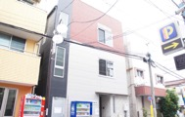
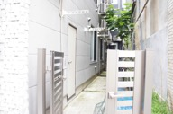
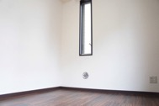
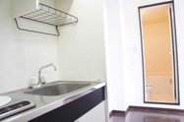
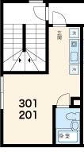
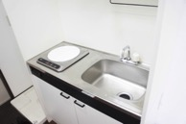
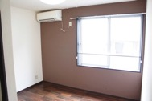
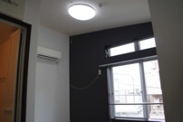
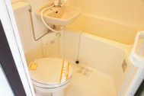
④Housing Information (for students who belong to Arakawa Campus)
Attachment
5-2
Closest Station | Higashi-Jujyo Station （3 minutes’ walk)
Address | Higashi-Jujyo, Kita-ku, Tokyo
Monthly Rent | 85,000 yen
Term of the Contract | September 1, 2017 to August 31, 2018 （The contract cannot be cancelled in the middle of the term）
Type of the room | Single (1 person)
Commuting time | 20 minutes （1 Transit）, Commuter Pass：8,050 yen/month（Kumano-Mae Station on Toden Arawaka Line)
Facilities | A Set of Bedding (Comforter, Blanket, etc.), Bed, Pillow, Sheets, Desk, Chair, Refrigerator, Rice Cooker, Microwave Oven, Air Conditioner and Coin-operated Washing Machine Internet (Monthly 5,000 yen)
Utilities | Make a contract with utilities companies and pay them each directly (Electricity, Gas and Water)
Notes | １．Rent for September 2017 and August 2018 will not be calculated on a per-diem basis even the student moves in/out in the middle of the month. ２．Available accommodation may not be same as above, depending on arrangements.

Slide 5
Attachment
5-2
■Housing Arrangement■※Housing arrangement shall not be canceled once the application form has been submitted.
・The term of contract is from September 1, 2017 to August 31, 2018 (for the fist year of study.)
・Check and agree to all the terms and conditions before applying for housing arrangement.
・You can get used to life in Japan while staying at arranged housing, and then find a new accommodation of your preference after August 2018.
① International Student House (Chofu)
【Payment 】 Rent shall be paid by the end of each month for the next month.
・ Deposit and rent for September 2017 shall be paid by overseas remittance before arrival in Japan.
【Lease Contract 】 The term of contract is from September 1, 2017 to August 31, 2018. You can terminate the contract with one month prior notification.
②③④ Recommended Housing
【Payment 】 Rent and internet fee shall be paid by the end of each month for the next month.
・ Rent for September 2017 shall be paid by overseas remittance before arrival in Japan.
・ Rent for Sept.2017 and Aug. 2018 will not be calculated on a per-diem basis; you must pay full rent even you move in/out in the middle of the month.
【Lease Contract 】 The term of contract is from September 1, 2017 to August 31, 2018. The contract shall not be cancelled in the middle of the term. In case of cancellation, the remaining rents shall be paid as a penalty of cancellation.
 | Deposit and Rent for September 2017 （First Payment） | Rent for October 2017 （Second Payment）
Amount of remittance | ・① International Student House (Chofu) 101,000yen （Deposit :30,000yen + Rent: 66,000yen ＋overseas remittance fee : about 5,000yen） | ・Rent for October 2017 : 66,000yen
Payment due date | August 31, 2017 | September 30, 2017
 | Rent for September 2017 （First Payment） | Rent for October 2017 （Second Payment）
Amount of remittance | ・②Minami-Osawa Campus, ③Hino Campus: 65,500yen （Rent:60,000yen＋overseas remittance fee :5,500yen） ・④Arakawa Campus: 90,500yen （Rent: 85,000yen＋overseas remittance fee:5,500yen） | ・②Minami-Osawa Campus, ③Hino Campus: 60,000yen ・④Arakawa Campus: 85,000yen
Payment due date | August 25, 2017 | September 30, 2017

Slide 6
Attachment
5-2
【Important Notes regarding the rules for International Student House / Recommended Housing】
【Points to attention】
・The occupancy is limited to the contract signer. The contract signer’s friends, relatives or family
members shall not be permitted to live together.
・If any occupant moves out in the middle of the contract, refund of rent shall not be made on
a per-diem basis.
・If any occupant causes damages to the equipment and others by willful misconduct or negligence,
the occupant shall be liable for the damages.
【Notes for residents】
・Smoking is prohibited in the room.
・The occupant is responsible to clean the room and common space, and maintain them in a clean
condition.
・Take out trash and garbage on the designated days after sorting out according to the rules set by
the local or housing community.
・Be aware of noise, and do not disturb the neighbors with noise. (Especially early morning and
late night hours.)

Slide 7
Attachment
5-2
■ Reference information ■
【 Difference between General Housing and TMU International Student House／Recommended Housing】
・ You usually need to pay a lot of money when renting housing in Japan, such as deposit, key money, fee for a guarantor company, etc. Besides these expenses, you may also have to pass the tenant screening in terms of credit history and reference. Therefore, it takes a lot of time to reach a rent contract.
Please check the following comparison information as the reference of renting general housing and International Student House / recommended housing.
【Initial cost when renting housing】
Title | Contents | General house | International Student House | Recommended house
Deposit | From it, the unpaid rent or repair cost, etc. are deducted. | 1 - 2 months’ rent worth | 30,000 JPY | 0
Key money | It is paid for the landlord as thank –you-money. | 1 month’ rent worth | 0 | 0
Guarantor company membership fee | When a tenant does NOT pay the rent, the guarantee company will pay instead | 0.5 - 1 month’ rent worth | 0 | 0
Cleaning fee | The cleaning fee at the time of move-out | 0.5 month’ rent worth | 0 | 0
Key replacement fee | The fee which is paid to replace the key | About 15,000 JPY | 0 | 0
Fire insurance | In the case of a fire, insurance will compensate for damage | About 20,000 JPY | 0 | 0
・In the case of renting general housing, about 4 months to 5 months ’s rent worth as initial cost is added to the rent, so the financial burden will increase. For example, if the monthly rent is 50,000 yen, usually the initial cost will be about 200,000 to 250,000 yen
【 Furniture, home appliances, etc. 】
・ In case of renting general housing, it’s necessary to prepare furniture, home appliances, etc. at your own expenses.
In International Student House / Recommended housing, all of the furniture and home appliances are already in place and there is no additional charge for them either (Exceptionally some washing machines and dryers may be charged.)

Slide 8
Attachment
5-2
【Short-term cancellation penalty】
Particle | Time of cancellation | General House | International Student House | Recommended House
Short-term cancellation of Lease Agreement | Within 1 year | 2 months’ rent required | No cancellation fee with one month prior notification. | No cancellation possible within 1 year
Short-term cancellation of Internet | Within 2 years | About 30,000 yen penalty | － | No cancellation possible within 1 year
・Despite the Lease Agreement of Recommended Housing can not be cancelled within 1 year, there is no penalty at the expiry time (2018, August 30).
【Reliable Support System】
Procedures/Trouble shooting | General House | International Student House | Recommended House
Application & cancellation procedures for electricity | By oneself | Unnecessary (Utilities cost is Included in the Rent.) | Supported By Management Company ( The renter needs to pay utilities cost.)
Application & cancellation procedures for gas | By oneself ※Attendance required
Application & cancellation procedures for water | By oneself
Application & cancellation procedures for Internet | By oneself ※Attendance required
Repair of malfunctioning equipment | By oneself | Supported | Supported
Availability of English speaking staff | Some real estate companies do not have English speaking staff. | Available | Available

